Slide 1
String operations

Slide 2
String Operations
Used for string and array processing, with the goal of writing efficient code.
The x88 instruction set has five groups of instructions for processing arrays of bytes and words.
Although they are called string primitives, they are not limited to character arrays
Next slide show these instruction and registers associated with them.

Slide 3
String Operations
Instruction | Description
MOVSB, MOVSW | Move string data: Copy data from memory addressed by DS:SI to memory addressed by ES:DI and updates SI and DI to point to the next locations.
CMPSB, CMPSW | Compare strings: Compare the contents of two memory locations addressed by DS:SI and ES:DI, and updates DI to point to the next location
SCASB, SCASW | Scan string: Compare the accumulator (AL or AX) to the contents of memory addressed by ES:DI, and updates DI to point to the next location. Flags are also updated accordingly
STOSB, STOSW | Store the accumulator contents into memory addressed by ES:DI, and updates DI to point to the next location
LODSB, LODSW | Load accumulator from string: Load memory addressed by DS:SI into the accumulator.

Slide 4
Update in SI and DI
In last slide its written the SI/ DI are updated with string instructions.
Updates are as follow
If DF=0
For Byte mode SI+1 , DI+1
For word mode SI+2, DI+2
That is, instructions are carried from start of block to end of block
If DF=1
For Byte mode SI-1 , DI-1
For word mode SI-2, DI-2
That is, instructions are carried from start of block to end of block

Slide 5
MOVS
The MOVSB and MOVSW MOVSD instructions copy data from the memory location pointed to by DS:SI to the memory location pointed to by ES:DI.
The two registers are either incremented or decremented automatically (based on the value of the Direction flag)
MOVSB Move (copy) bytes
MOVSW Move (copy) words

Slide 6
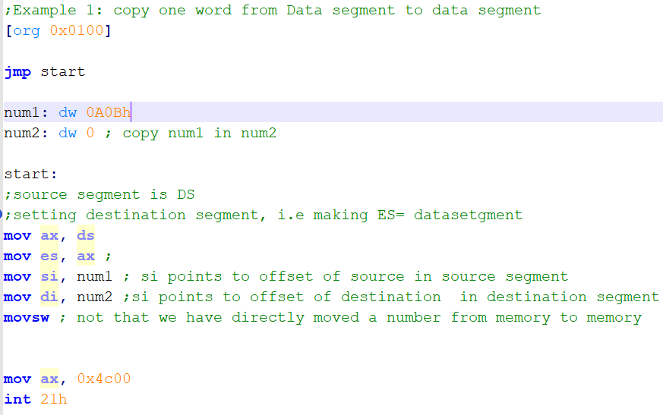
Example: MOVS
Notes:
;Example 1: copy one word from Data segment to data segment
[org 0x0100]
jmp start
num1: dw 0A0Bh
num2: dw 0 ; copy num1 in num2
start:
;source segment is DS
;setting destination segment, i.e making ES= datasetgment
mov ax, ds
mov es, ax ;
mov si, num1 ; si points to offset of source in source segment
mov di, num2 ;si points to offset of destination in destination segment
movsw ; not that we have directly moved a number from memory to memory
mov ax, 0x4c00
int 21h

Slide 7
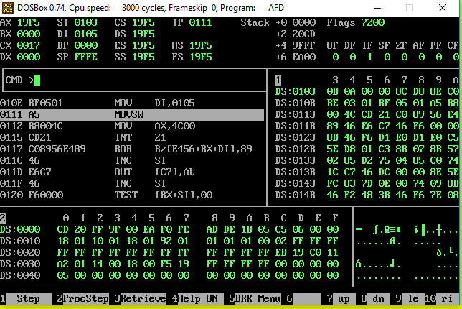
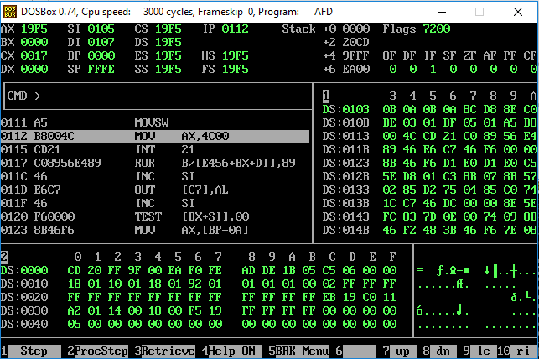
Before and after execution of MOVSW
As DF is clear, SI and DI are incremented by 2.
Data is moved to destination

Slide 8
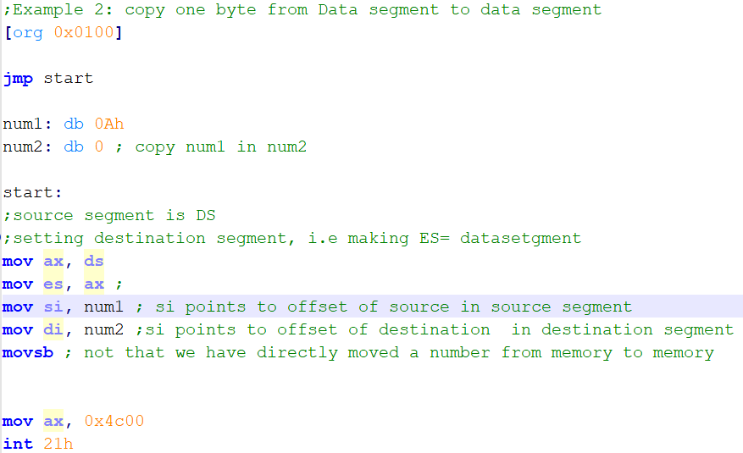
Example Movsb
Notes:
;Example 2: copy one byte from Data segment to data segment
[org 0x0100]
jmp start
num1: db 0Ah
num2: db 0 ; copy num1 in num2
start:
;source segment is DS
;setting destination segment, i.e making ES= datasetgment
mov ax, ds
mov es, ax ;
mov si, num1 ; si points to offset of source in source segment
mov di, num2 ;si points to offset of destination in destination segment
movsb ; not that we have directly moved a number from memory to memory
mov ax, 0x4c00
int 21h

Slide 9
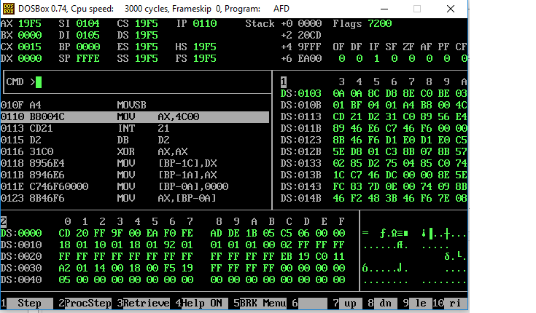
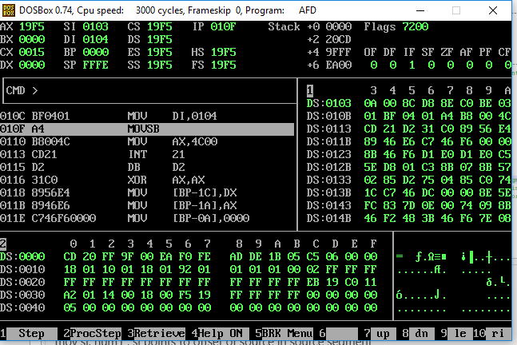
Before and after execution of MOVSB
As DF is clear, SI and DI are incremented by 1.
Data is moved to destination

Slide 10
REP instruction
REP repeats the following string instruction CX times.
The use of CX is implied with the REP prefix
CX is decremented after each repetition
The decrement in CX doesn’t affect any flags

Slide 11
MOVS with REP
We can used MOVS and REP together to copy an chunk of data from source to destination
Data can be copied from end to start of block or start to end of block
Steps to Mov n words from Source to destination from start to end
Cld ; clear DF so that data is copied from start to end
Set DS:SI
Set ES:SI
Set cx to n, i.e number of words to be moved
REP MOVSW; this instruction will run MOVSW n time after each time cx is decremented by 1 and SI and DI are incremented by 2

Slide 12
MOVSW and REP with DF=0
DS:SI
ES:DI
1 | 13 | 14 | A | 67 | 8 | 79 | 10
Mov cx, 3; number of words to be moved
REP MOVSW ; movsw will run 3 times now
1 MOVSW, CX=2
DS:SI
ES:DI
1 | 13 | 14 | A | 67 | 8 | 79 | 10
1 | 13
2 MOVSW, CX=1
DS:SI
ES:DI
1 | 13 | 14 | A | 67 | 8 | 79 | 10
1 | 13 | 14 | A
3 MOVSW, CX=0
DS:SI
ES:DI
1 | 13 | 14 | A | 67 | 8 | 79 | 10
1 | 13 | 14 | A | 67 | 8
What will you change is you want to copy all 4 words?

Slide 13
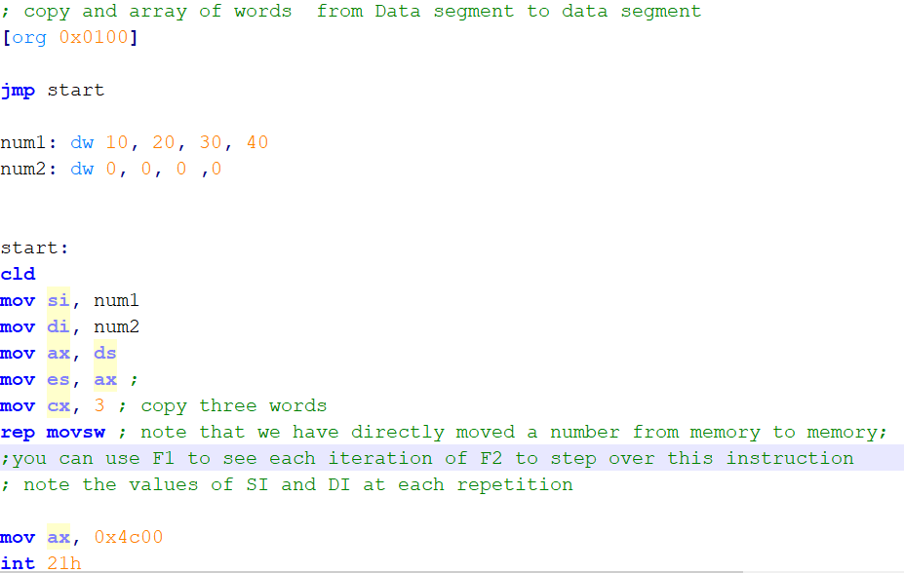
MOVSW with REP
Notes:
; copy and array of words from Data segment to data segment
[org 0x0100]
jmp start
num1: dw 10, 20, 30, 40
num2: dw 0, 0, 0 ,0
start:
cld
mov si, num1
mov di, num2
mov ax, ds
mov es, ax ;
mov cx, 3 ; copy three words
rep movsw ; note that we have directly moved a number from memory to memory;
;you can use F1 to see each iteration of F2 to step over this instruction
; note the values of SI and DI at each repetition
mov ax, 0x4c00
int 21h

Slide 14
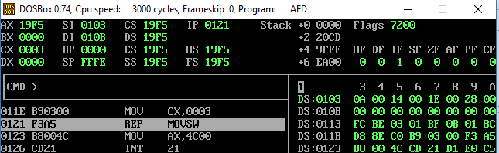
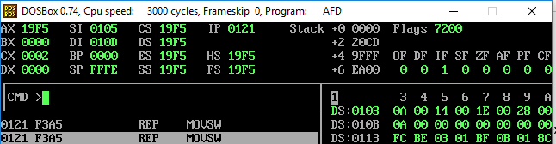
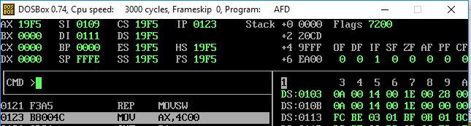
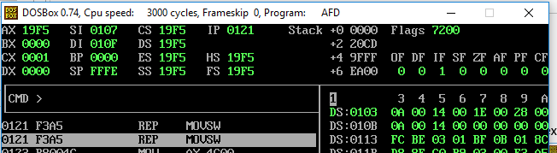
Debugging Example 3
Notice the value of DI, SI, CX and memory state before and after execution of each step

Slide 15
MOVSB with REP
MovSB with REP works in same way as MOVSW with REP
Only difference is SI, DI are incremented/Decremented by 1
CX will be number of bytes you want to copy

Slide 16
MOVSW and REP with DF=0
DS:SI
ES:DI
1 | 13 | 14 | A | 67 | 8 | 79 | 10
Mov cx, 3; number of words to be moved
REP MOVSb ; movsb will run 3 times now
1 MOVSW, CX=2
DS:SI
ES:DI
1 | 13 | 14 | A | 67 | 8 | 79 | 10
1
2 MOVSW, CX=1
DS:SI
ES:DI
1 | 13 | 14 | A | 67 | 8 | 79 | 10
1 | 13
3 MOVSW, CX=0
DS:SI
ES:DI
1 | 13 | 14 | A | 67 | 8 | 79 | 10
1 | 13 | 14
What will you change is you want to copy all 8 bytes?

Slide 17
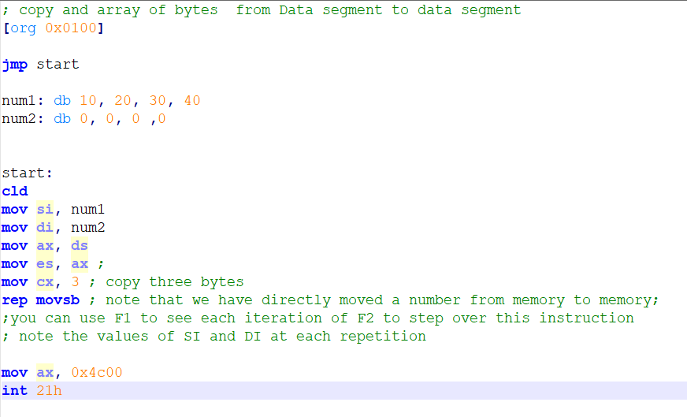
MOVSB with REP Example
Notes:
; copy and array of bytes from Data segment to data segment
[org 0x0100]
jmp start
num1: db 10, 20, 30, 40
num2: db 0, 0, 0 ,0
start:
cld
mov si, num1
mov di, num2
mov ax, ds
mov es, ax ;
mov cx, 3 ; copy three bytes
rep movsb ; note that we have directly moved a number from memory to memory;
;you can use F1 to see each iteration of F2 to step over this instruction
; note the values of SI and DI at each repetition
mov ax, 0x4c00
int 21h

Slide 18
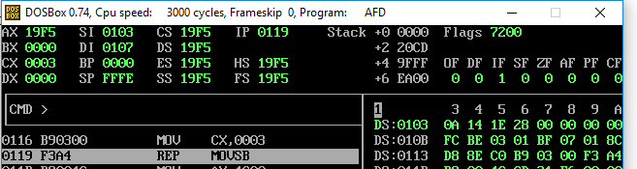
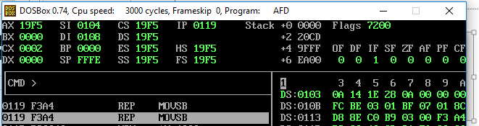
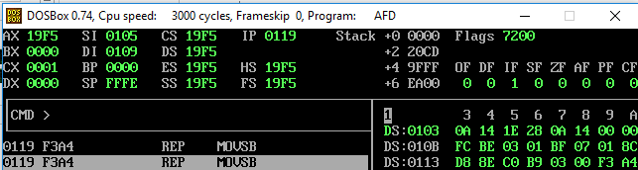
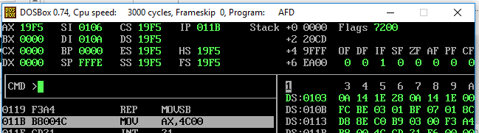
Debugging MOVSB with REP Example
Notice the value of DI, SI, CX and memory state before and after execution of each step

Slide 19
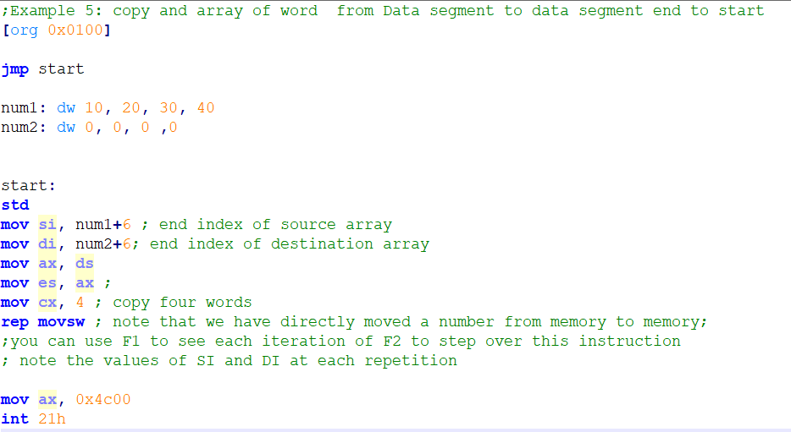
Order of moving data using MOVS
To copy block of data from end to start set DF using std instruction.
Example
Notes:
;Example 5: copy and array of word from Data segment to data segment end to start
[org 0x0100]
jmp start
num1: dw 10, 20, 30, 40
num2: dw 0, 0, 0 ,0
start:
std
mov si, num1+6 ; end index of source array
mov di, num2+6; end index of destination array
mov ax, ds
mov es, ax ;
mov cx, 4 ; copy four words
rep movsw ; note that we have directly moved a number from memory to memory;
;you can use F1 to see each iteration of F2 to step over this instruction
; note the values of SI and DI at each repetition
mov ax, 0x4c00
int 21h

Slide 20
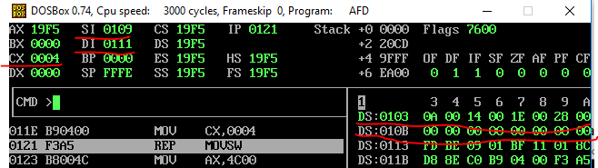
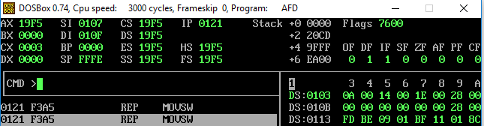
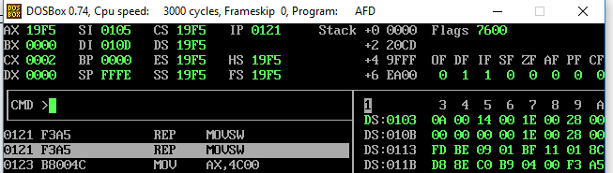
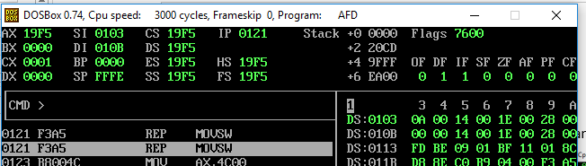
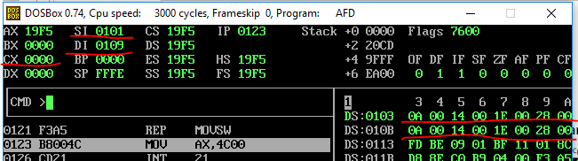
Debugging Example
Notice the value of DI, SI, CX and memory state before and after execution of each step

Slide 21
Why do we need two different orders of MOVS?
The DF is important in the case of overlapping blocks.
For example when the source and destination blocks overlap and the source is below the destination copy must be done upwards.
While if the destination is below the source copy must be done downwards

Slide 22
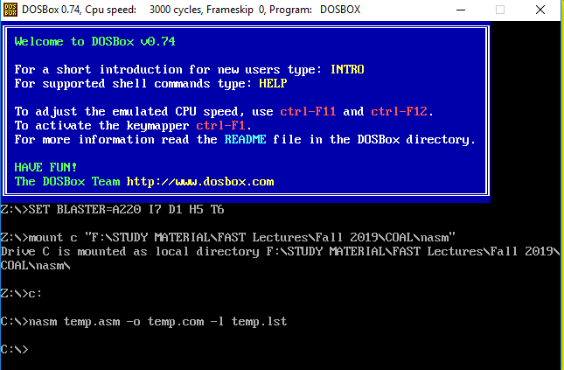
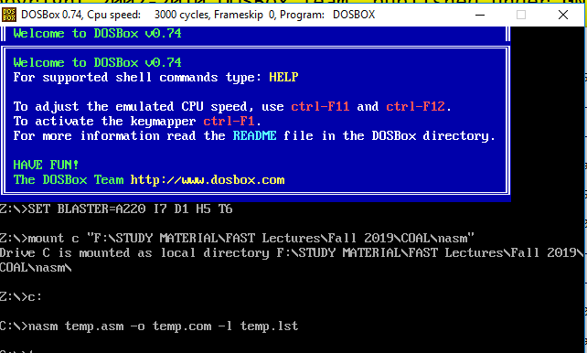
Exercise of MOVS
Write a code the will take first line of screen (whatever is written their) and will print the same line of second line. Sample runs are given. The code is in temp.com file. Hint: You can change DS register to point to B8000

Slide 23
CMPS
Compare string

Slide 24
CMPS
Compares block of data given at source and destination
CMPS has two variants:
CMPW: Compare block word by word
CMPSB: Compares block byte by byte
Used in pair with REPE or REPNE and conditional Jump
REPE: repeats a long and blocks are same (can be used to check equality of blocks) or until CX >zero
REPNE: repeats a long and blocks are different (can be used to see check common elements in string) or until CX >zero
Flags are updated accordingly and conductional jumps can be used afterwards.
DF has same use here as in MOVS, i.e. to control direction of comparison

Slide 25
CMPSW
Syntax:
Cld/ std
Set source and Destination segments
Set Source starting index
Set destination starting index
Set cx to length of block
REPE/REPNE CMPSW
Conditional Jump
Note that SI and DI are auto incremented/ Decremented by 2 and CX is also decremented, as you saw in MOVSW

Slide 26
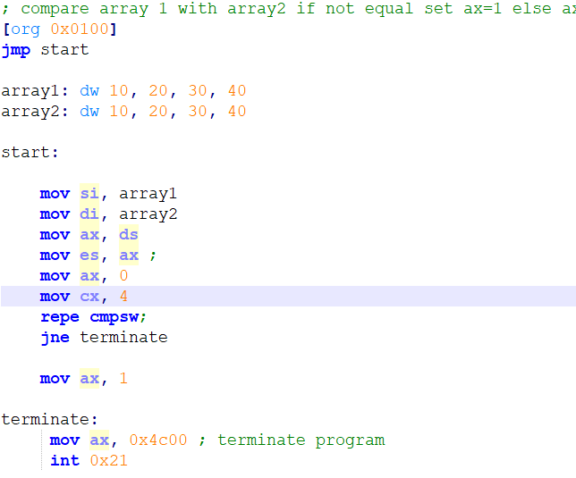
CMPSW
Run this example with different values of arrays
Note that SI and DI are auto incremented here and CX is Zero after execution.
Notes:
; compare array 1 with array2 if not equal set ax=1 else ax=0
[org 0x0100]
jmp start
array1: dw 10, 20, 30, 40
array2: dw 10, 20, 30, 40
start:
cld
mov si, array1
mov di, array2
mov ax, ds
mov es, ax ;
mov ax, 0
mov cx, 4
repe cmpsw;
jne terminate
mov ax, 1
terminate:
mov ax, 0x4c00 ; terminate program
int 0x21

Slide 27
CMPSB
Compares blocks byte by byte
SI and DI are incremented / decremented 1 by 1
Rest is same as CMPW
See example 7.7 from BH for string comparison

Slide 28
Exercise
Find a substring in a string and place the stating point of substring in ax. If substring is not found place -1 in ax.
For example string = ABCABD and substring =ABD then ax should be 3
For example string = ABCABX and substring =ABD then ax should be -1
For example string = ABCABD and substring =ABC then ax should be 0

Slide 29
SCAS
Scan string

Slide 30
SCAS
Compares value in accumulator to all elements in a block starting at ES:DI
Has two variants
SCASW: Compares AX with all word in block one by one (SI, DI +/- 2)
SCASB: Compares AL with all bytes in block one by one (SI, DI +/- 1)
REPE
scans and array/string while CX > 0 and the value in AL/AX matches each subsequent value in memory
REPNE
scans until either AL/AX matches a value in memory or till CX becomes 0
Flag are updated accordingly
Use conduction jump

Slide 31
SCASW
Syntax:
Cld/ std
Set Destination segments
Set destination starting index
Set ax to element to be found
Set cx to length of block
REPE/REPNE SCAW
Conditional Jump

Slide 32
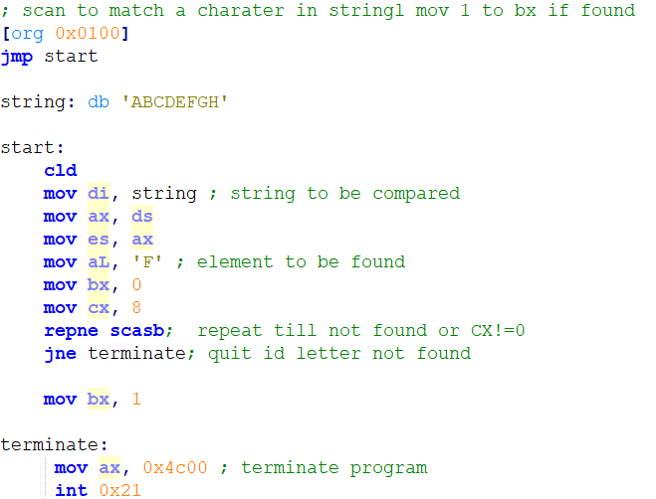
Example
Try this example with different values of string and al
Note that DI points to one element beyond where F was found.
Notes:
; scan to match a charater in stringl mov 1 to bx if found
[org 0x0100]
jmp start
string: db 'ABCDEFGH'
start:
cld
mov di, string ; string to be compared
mov ax, ds
mov es, ax
mov aL, 'F' ; element to be found
mov bx, 0
mov cx, 8
repne scasb; repeat till not found or CX!=0
jne terminate; quit id letter not found
mov bx, 1
terminate:
mov ax, 0x4c00 ; terminate program
int 0x21

Slide 33
Exercise
Write a code that will scan an array of numbers (word size) and places 0 in BX is number is not found and 1 if found
Read and run Example 7.3 from BH to use SCAS to find the length of string ending with null for example:
message: db 'hello world', 0
Write a code the will find the frequency of ‘B’ in string using scas.
For example string db: ‘AAABCDBB’
At the end of your code BX should be 2

Slide 34
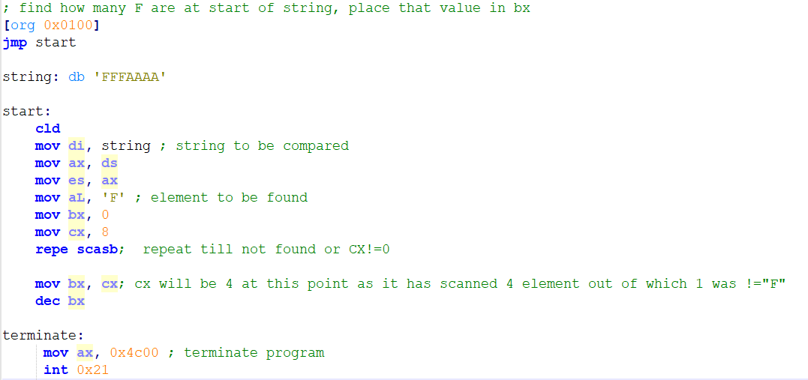
Example 2:
Notes:
; find how many F are at start of string, place that value in bx
[org 0x0100]
jmp start
string: db 'FFFAAAA'
start:
cld
mov di, string ; string to be compared
mov ax, ds
mov es, ax
mov aL, 'F' ; element to be found
mov bx, 0
mov cx, 8
repe scasb; repeat till not found or CX!=0
mov bx, cx; cx will be 4 at this point as it has scanned 4 element out of which 1 was !="F"
dec bx
terminate:
mov ax, 0x4c00 ; terminate program
int 0x21

Slide 35
STOS
Store string

Slide 36
STOS
STOS transfers a byte or word from register AL or AX to the string element addressed by ES:DI and updates DI to point to the next location.
STOS is often used to clear a block of memory or fill it with a constant.
If DF is clear, DI will be incremented by one or two depending of whether STOSB or STOSW is used.
If REP is used before this instruction, the process will be repeated CX times.
Note that values of ax/al cannot be changed during one rep stos

Slide 37
Syntax
Cld/std
Set destination
Set ax/al; element to be copied at destination
Set cx to size of block
Rep stosb/ stosw

Slide 38
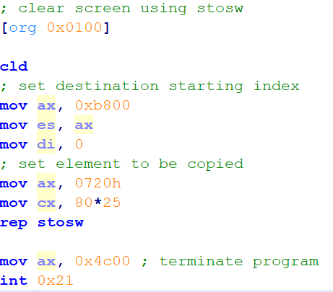
Example: STOSW to clear screen
Notes:
; find how many F are at start of string, place that value in bx
[org 0x0100]
cld
; set destination starting index
mov ax, 0xb800
mov es, ax
; set element to be copied
mov ax, 0720h
mov cx, 80*25
rep stosw
mov ax, 0x4c00 ; terminate program
int 0x21

Slide 39
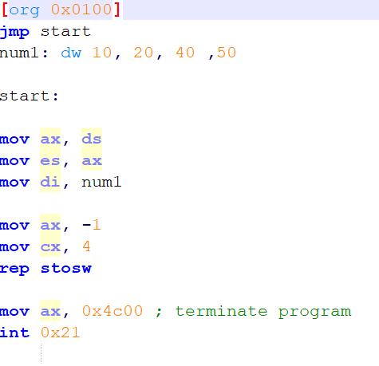
Example of STOSW to copy -1 in whole array
Notes:
[org 0x0100]
jmp start
num1: dw 10, 20, 40 ,50
start:
mov ax, ds
mov es, ax
mov di, num1
mov ax, -1
mov cx, 4
rep stosw
mov ax, 0x4c00 ; terminate program
int 0x21

Slide 40
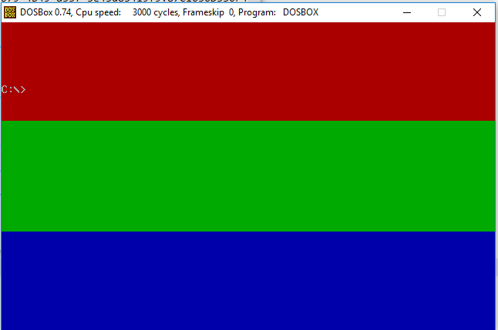
Exercise
Change the code given in previous slide to color screen as shown

Slide 41
LODS
Load String

Slide 42
LODS
LODS transfers a byte or word from the source location DS:SI to AL or AX and updates SI to point to the next location.
Again SI is incremented/ Decprement depeding on DF and by 1 or 2 depending on lodsb or lodsw
LODS is generally used in a loop and not with the REP prefix
since the value previously loaded in the register is overwritten
if the instruction is repeated and only the last value of the block remains in the register

Slide 43
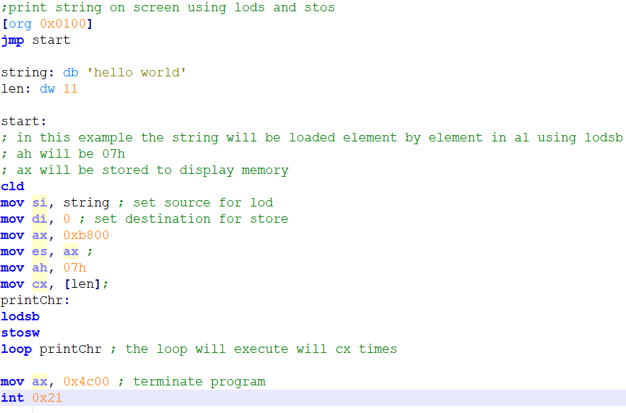
Example: LODS to print string on screen
See this same example form book as subroutine
Loop instruction will jump to label until cx is not zero
At each iteration of loop CX is decremented
Notes:
;print string on screen using lods and stos
[org 0x0100]
jmp start
string: db 'hello world'
len: dw 11
start:
; in this example the string will be loaded element by element in al using lodsb
; ah will be 07h
; ax will be stored to display memory
cld
mov si, string ; set source for lod
mov di, 0 ; set destination for store
mov ax, 0xb800
mov es, ax ;
mov ah, 07h
mov cx, [len];
printChr:
lodsb
stosw
loop printChr ; the loop will execute will cx times
mov ax, 0x4c00 ; terminate program
int 0x21

Slide 44
LES and LDS Instructions
In all of string instructions source and destination are segment offset pair.
LES and LDS make it easier to copy values to ES:DI and DS:SI in one statement by loading segment and general purpose registers from consecutive memory locations in one instruction.
Syntax
LES <general purpose register>, mem location
Will load value on mem location to GP reg and mem+2 value to ES
LDS <general purpose register>, mem location
Will load value on mem location to GP reg and mem+2 value to DS
Example:
If caller pushed value of ES and then value of DI
Value of Di is at bp+4 and Value of ES is at bp+6
Following instruction in function will load bp+4 to di and bp+6 to ES
LES di, [bp+4]
Similarly, “lds si, [bp+4]” will load SI from BP+4 and DS from BP+6.

